Slide 1

Object Composition
Closures, Revealing Module Pattern, Object Inheritance, Prototypes
SoftUni Team
Technical Trainers
Software University
http://softuni.bg

Slide 2
Table of Content
Object Composition
Closures
Module and Revealing Module Patterns
Object Inheritance and Prototype Chain
Objects Interacting with DOM

Slide 3
Have a Question?
sli.do
#JSCORE

Slide 4


Object Composition
Objects Holding Other Objects

Slide 5
What is Object Composition?
Object composition == combining simple objects or data types into more complex ones
let student = {
firstName: 'Maria',
lastName: 'Green',
age: 22,
location: { lat: 42.698, lng: 23.322 }
}
console.log(student);
console.log(student.location.lat);

Slide 6
Composing Objects
let name = "Sofia";
let population = 1325744;
let country = "Bulgaria";
let town = { name, population, country };
console.log(town); // Object {name: "Sofia", population: 1325744, country: "Bulgaria"}
Combine variables into object
town.location = { lat: 42.698, lng: 23.322 };
console.log(town); // Object {…, location: Object}

Slide 7
Combining Data with Functions
let rect = {
width: 10,
height: 4,
grow: function(w, h) {
this.width += w; this.height += h;
},
print: function() {
console.log(`[${this.width} x ${this.height}]`);
}
};
rect.grow(2, 3);
rect.print(); // [12 x 7]

Slide 8
Printing Objects: toString() Function
let rect = {
width: 10,
height: 4,
toString: function() {
return `rect[${this.width} x ${this.height}]`;
}
};
console.log(rect); // Object {width: 10, height: 4}
// This will invoke toString() to convert the object to String
console.log('' + rect); // rect[12 x 7]

Slide 9
Problem: Order Rectangles by Size
You are given a set of rectangles (width x height) as nested arrays
Order them by their area, then by width (descending)
[3, 4], [5, 3], [3, 4], [3, 5], [12, 1]
[5, 3], [3, 5], [12, 1], [3, 4], [3, 4]
[2, 2.5], [2.5, 2]
[2.5, 2], [2, 2.5]

Slide 10
Solution: Order Rectangles by Size
function createRect(width, height) {
let rect = {
width: width,
height: height,
area: () => rect.width * rect.height,
compareTo: function(other) {
let result = other.area() - rect.area();
return result || (other.width - rect.width);
}
};
return rect;
}

Slide 11
Solution: Order Rectangles by Size (2)
function orderRects(rectsData) {
let rects = [];
for (let [width, height] of rectsData) {
let rect = createRect(width, height);
rects.push(rect);
}
rects.sort((a,b) => a.compareTo(b));
return rects;
}
orderRects([[3, 4], [5, 3], [3, 4], [3, 5], [12, 1]])
Check your solution here: https://judge.softuni.bg/Contests/334

Slide 12
counter
1
function
function
function
Closures
Enclosing Object State in a Function

Slide 13
What is Closure?
Closure == state maintained (closed) inside a function
Hidden from the outside world
Example: counter with closures
function counterClosure() {
let counter = 0;
function getNextCount() {
console.log(++counter);
};
return getNextCount;
}
let count
counterClosure();
count(); // 1
count(); // 2
count(); // 3
count(); // 4
count(); // 5

Slide 14
Closures – Shorter Syntax with IIFE
let counter = (function() {
let num = 0;
return function() {
console.log(++num);
};
})();
counter(); // 1
counter(); // 2
counter(); // 3
let counter = (() => {
let num = 0;
return () =>
console.log(++num);
})();
counter(); // 1
counter(); // 2
counter(); // 3
counter(); // 4

Slide 15
Problem: Fibonacci with Closures
Using closures write a JS function that returns the next Fibonacci number, each time it's called
x5
x4
x3
1
1
2
3
5
1
1
2
3
1
1
2

Slide 16
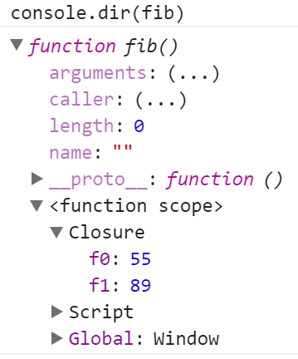
Solution: Fibonacci with Closures
function getFibonator() {
let f0 = 0, f1 = 1;
return function() {
let f2 = f0 + f1;
f0 = f1;
f1 = f2;
return f0;
};
}
let fib = getFibonator();
fib(); // 1
fib(); // 1
fib(); // 2
Check your solution here: https://judge.softuni.bg/Contests/334

Slide 17
closure
counter
5
function
object
increase()
decrease()
value()
object { }
Module and Revealing Module Patterns

Slide 18
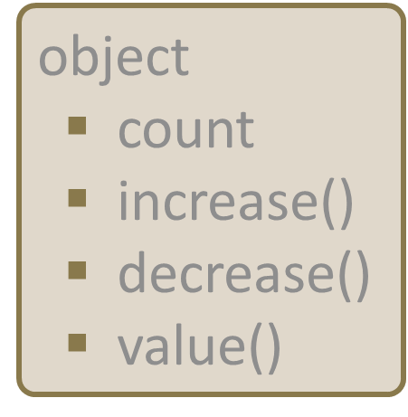
"Module" Pattern (with Object Literal)
let moduleObj = {
count: 0, // public
increase: function(num) { return this.count += num },
decrease: function(num) { return this.count -= num },
value: function() { return this.count }
};
moduleObj.count = 2; // the counter is accessible
console.log(moduleObj.value()); // 2
console.log(moduleObj.increase(5)); // 7
console.log(moduleObj.decrease(1)); // 6

Slide 19
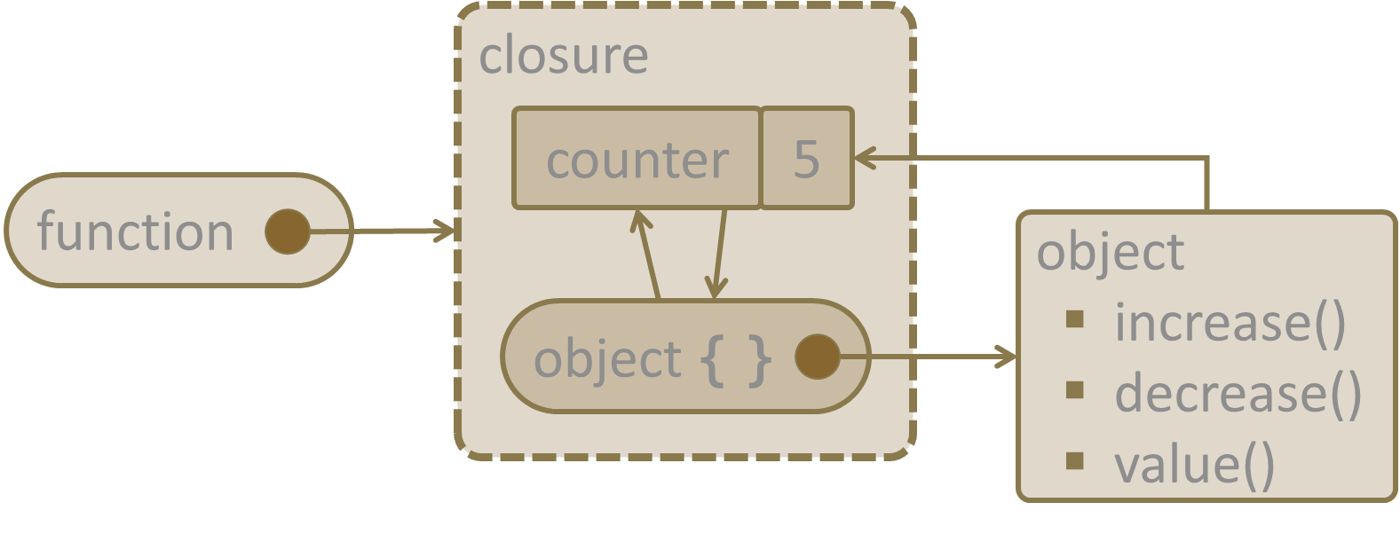
"Module" Pattern (with Closure)
let module = (function() {
let count = 0; // private
return {
increase: (num) => count += num,
decrease: (num) => count -= num,
value: () => count,
};
})();
console.log(module.value()); // 0
console.log(module.increase(5)); // 5
console.log(module.decrease(2)); // 3
console.log(module.count); // undefined (not accessible)

Slide 20
"Revealing Module" Pattern (with Closure)
let revModule = (function() {
let count = 0; // private
function change(amount) { return count += amount; }
function increase(num) { return change(num); }
function decrease(num) { return change(-num); }
function value() { return count; }
return { increase, decrease, value };
})();
console.log(revModule.value()); // 0
console.log(revModule.increase(5)); // 5
console.log(revModule.decrease(2)); // 3
console.log(revModule.count); // undefined (not accessible)

Slide 21
Problem: List Processor
Using a closure (IIFE holding a state inside it) implement a command execution engine to process list commands like shown below
add hello
add again
remove hello
add again
print
hello
hello, again
again
again, again
again, again
again, again

Slide 22
Solution: List Processor
let commandProcessor = (function() {
let list = [];
return {
add: (newItem) => list.push(newItem),
remove: (item) => list = list.filter(x => x != item),
print: () => console.log(list)
}
})();

Slide 23
Solution: List Processor (2)
function processCommands(commands) {
let commandProcessor = (function(){ … })();
for (let cmd of commands) {
let [cmdName, arg] = cmd.split(' ');
commandProcessor[cmdName](arg);
}
}
processCommands(['add hello', 'add again', 'remove hello', 'add again', 'print']);
Check your solution here: https://judge.softuni.bg/Contests/334

Slide 24
fatherCar
brand
BMW
model
X5
color
blue
myCar
workCar
model
M4
model
i3
color
red
type
electric
Object Inheritance

Slide 25
Object Inheritance
let fatherCar = { brand: 'BMW',
model: 'X5', color: 'blue',
toString: function() { return `[brand: ${this.brand}, model: ${this.model}, color: ${this.color}]`; }
};
console.log('' + fatherCar);
fatherCar
brand
BMW
model
X5
color
blue
let myCar = Object.create(fatherCar);
myCar.model = 'M4';
myCar.color = 'red';
console.log('' + myCar);
myCar
model
M4
Object.create() inherits an object
color
red

Slide 26
Object Inheritance (2)
fatherCar
let workCar =
Object.create(fatherCar);
workCar.model = 'i3';
workCar.type = 'electric';
workCar.toString = function() {
return `[brand: ${this.brand}, model: ${this.model}, color: ${this.color}, type: ${this.type}]`;
}
console.log('' + workCar);
brand
BMW
model
X5
color
blue
workCar
model
i3
type
electric

Slide 27
Prototype Chain
myCar
fatherCar
model
M4
brand
BMW
color
red
Object
model
X5
__proto__
color
blue
__proto__
workCar
model
i3
type
electric
__proto__

Slide 28
Prototype Chain
Objects have prototype (a parent object)
Prototypes form a prototype chain
If a property is not found in the object itself, it is searched in the parent objects (in the prototype chain)
Object.getPrototypeOf(fatherCar);
// Object {}
Object.getPrototypeOf(myCar);
// Object {brand: "BMW", model: "X5", color: "blue"}

Slide 29
Problem: Object Inheritance
Write a JS function to execute commands which create, inherit and modify objects:
create c1
create c2 inherit c1
set c1 color red
set c2 model new
print c1
print c2
c1
c1
c2
c1 { color:red}
c2
c1 { color:red}
c2 {model:new}
color:red
model:new, color:red

Slide 30
Solution: Object Inheritance – Parser
function processCommands(commands) {
let map = new Map();
let cmdExecutor = { … };
for (let command of commands) {
let commandParameters = command.split(' ');
let action = commandParameters.shift();
cmdExecutor[action](commandParameters);
}
}
processCommands(['create c1','create c2 inherit c1'])
c1
c1 {}
map
c2
c2 {}

Slide 31
Solution: Object Inheritance – Executor
let cmdExecutor = {
create: function ([objName, inherits, parent]) {
parent = parent ? map.get(parent) : null;
let newObj = Object.create(parent);
map.set(objName, newObj);
return newObj;
},
set: function ([objName, key, value]) {
let obj = map.get(objName);
obj[key] = value;
},
print: function ([objName]) {
let obj = map.get(objName), objects = [];
for (let key in obj) { objects.push(`${key}:${obj[key]}`); }
console.log(objects.join(', '));
}
};
Check your solution here: https://judge.softuni.bg/Contests/334

Slide 32
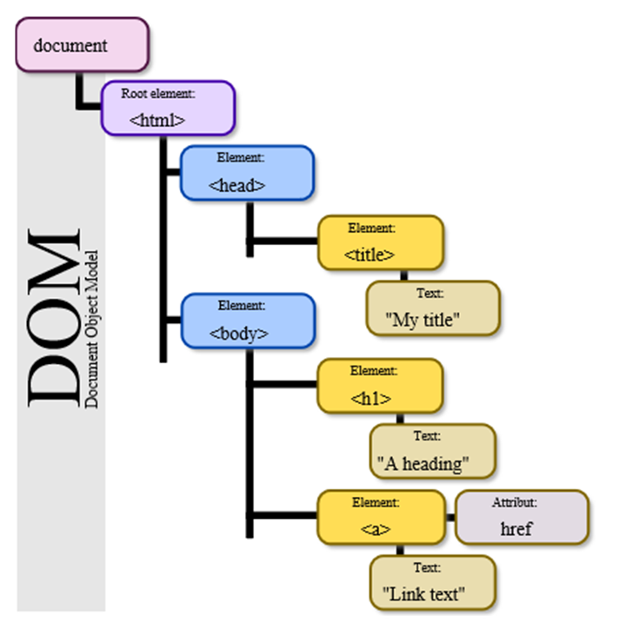
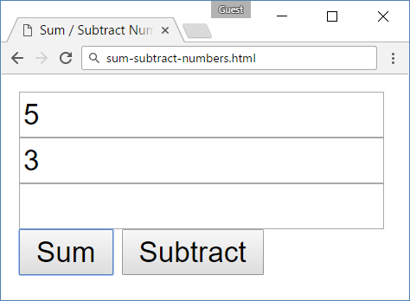
model
init
function
add
function
subtract
function
Objects Interacting with DOM

Slide 33
Problem: Sum / Subtract Numbers
You are given the following HTML form
<input type="text" id="num1" />
<input type="text" id="num2" />
<input type="text" id="result" readonly />
<br>
<button id="sumButton">
Sum</button>
<button id="subtractButton">
Subtract</button>

Slide 34
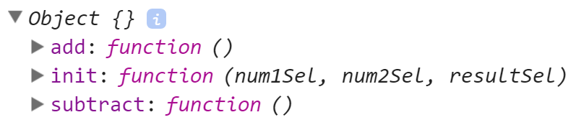
Problem: Sum / Subtract Numbers (2)
Write a JS function getModel() to return a JS object holding
function init(num1Sel, num2Sel, resultSel) → initializes selectors for finding the fields num1, num2 and result in the DOM
function add() → calculates result = num1 + num2
function subtract() → calculates result = num1 - num2

Slide 35
Problem: Sum / Subtract Numbers (3)
This is how the getModel() function can be used to implement add / subtract operatons in the DOM tree:
$(function() {
let model = getModel();
model.init('#num1', '#num2', '#result');
$('#sumButton').click(model.add);
$('#subtractButton').click(model.subtract);
});

Slide 36
Solution: Sum / Subtract Numbers
// Solution using the "Module" pattern
function getModel() {
let model = {
init: function(num1Sel, num2Sel, resultSel) {
model.num1 = $(num1Sel);
model.num2 = $(num2Sel);
model.result = $(resultSel);
},
add: () => model.action((a, b) => a + b),
subtract: () => model.action((a, b) => a - b),

Slide 37
Solution: Sum / Subtract Numbers (2)
action: function(operation) {
let val1 = Number(model.num1.val());
let val2 = Number(model.num2.val());
model.result.val(operation(val1, val2));
}
};
return model;
}
Check your solution here: https://judge.softuni.bg/Contests/334

Slide 38
Another Solution: Sum / Subtract Numbers
// Solution using the "Revealing Module" pattern
function getModel() {
let num1, num2, result;
function init(num1Sel, num2Sel, resultSel) {
num1 = $(num1Sel);
num2 = $(num2Sel);
result = $(resultSel);
}
function add() { action((a, b) => a + b); }
function subtract() { action((a, b) => a - b); }

Slide 39
Another Solution: Sum / Subtract Numbers (2)
function action(operation) {
let val1 = Number(num1.val());
let val2 = Number(num2.val());
result.val(operation(val1, val2));
}
let model = { init, add, subtract };
return model;
}
Check your solution here: https://judge.softuni.bg/Contests/334

Slide 40

Live Exercises

Slide 41

Summary
Object composition combines data and functions into JS objects
The "Module" pattern hides data into a function and reveals a JS object
The "Revealing Module" pattern hides data and functions are reveals them as JS object
Objects can inherit parent object by Object.create(parent)
…
…
…
let r = {w:5, h:3, grow:function() { … }}

Slide 42
https://softuni.bg/trainings/2081/js-advanced-october-2018

Slide 43













SoftUni Diamond Partners

Slide 44





SoftUni Organizational Partners

Slide 45




Trainings @ Software University (SoftUni)
Software University – High-Quality Education and Employment Opportunities
softuni.bg
Software University Foundation
http://softuni.foundation/
Software University @ Facebook
facebook.com/SoftwareUniversity
Software University Forums
forum.softuni.bg

Slide 46

License
This course (slides, examples, demos, videos, homework, etc.) is licensed under the "Creative Commons Attribution-NonCommercial-ShareAlike 4.0 International" license

